Slide 1
Anonymous and Safe Relinquishment
of a Newborn Baby
Hospital Training

Slide 2
The Ideal World
All pregnancies would be planned and wanted
Newborns welcomed into the home
Raised in a safe and loving household

Slide 3
Why a Pregnancy May Not be Welcomed
Admission of pregnancy
Sexual assault
Fear of confronting disapproving family
Fear of disownment
Fear of death

Slide 4
Consequences of Hiding a Pregnancy
No prenatal care
No mental health counseling or services
No counseling for a traditional adoption
Notes:
If you were to receive a baby born to a mother who had no prenatal care, you might be more likely see problems in the newborn. The mother may not know that she could give the child up and go through the traditional adoption process

Slide 5
Consequences of Hiding a Pregnancy
Deliver on her own with no medical care
Abandonment of a newborn in an unsafe place
Houston– Hours-old baby found covered in ants 8/12/2017
California– Woman charged with trying to kill baby in toilet 9/4/2017
Notes:
One of the biggest concerns though is that she may deliver on her own with no medical care. And as we’ve seen in so many cases across the U.S., the mother, out of fear or lack of knowledge will leave the newborn in an unsafe place.

Slide 6
The Utah Newborn Safe Haven, or 'baby drop-off' law, allows a birth mother or any other person to anonymously turn over a newborn to any employee at a Utah hospital.

Slide 7
The Law …
• Protects infants from injury and death
• Provides a safe place for newborns
• Allows secrecy and anonymity for any person dropping off the newborn
(Utah Code Ann. Sec. § 62A-4a-802)
Notes:
The law is in place for a very specific reason – and that is that other newborns around the country were being abandoned in unsafe places and it still happens to this day despite the laws. Has anyone heard about any unsafe dropoffs in the U.S. or anywhere else? Go back to slide;

Slide 8
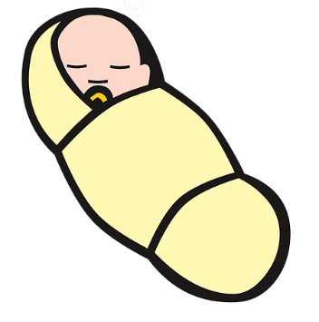
Utah Law
Newborns 3 days old
(Accept any child any person tries to give you!)
Newborn taken or dropped off at a hospital
To emergency room for a health evaluation
Notes:
So you have the newborn. Before the person dropping off leaves, depending upon their mood, demeanor, you can ask the person to answer some questions

Slide 9
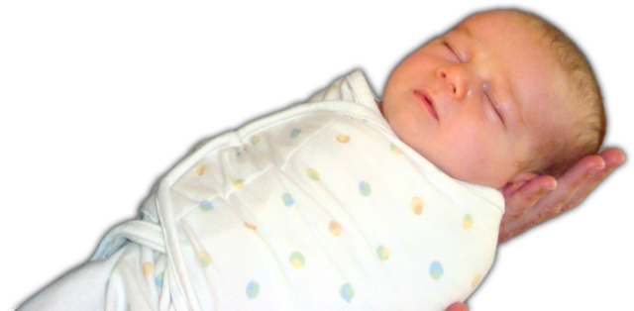
Do not hesitate
to accept a newborn
from anyone!
Notes:
So you have the newborn. Before the person dropping off leaves, depending upon their mood, demeanor, you can ask the person to answer some questions

Slide 10
Medical History of the Newborn
A person dropping off the newborn may wish to provide medical information on the health of the infant or medical history of the parents.
Names should not be given.
Medical History Form can be found at
http://www.utahsafehaven.org/wp-content/uploads/2012/02/Medical_Questionnaire_1.pdf
Notes:
So you have the newborn. Before the person dropping off leaves, depending upon their mood, demeanor, you can ask the person to answer some questions

Slide 11
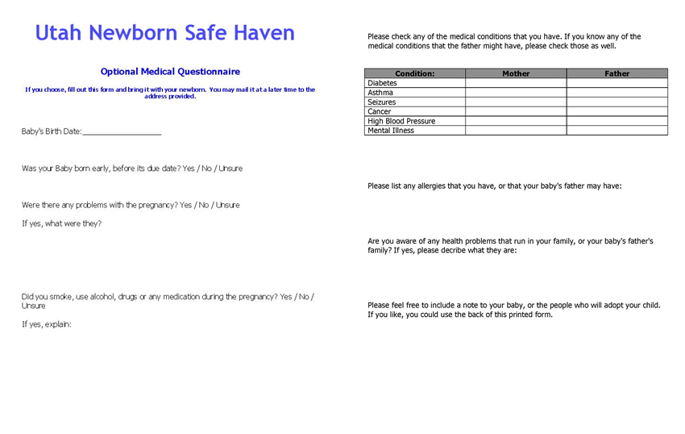

Slide 12
Hospital Responsibilities
Health evaluation on newborn
Notify Hospital Birth Certificate Clerk
Contact Utah Division of Child and Family Services (DCFS)
1-855-323-3237

Slide 13
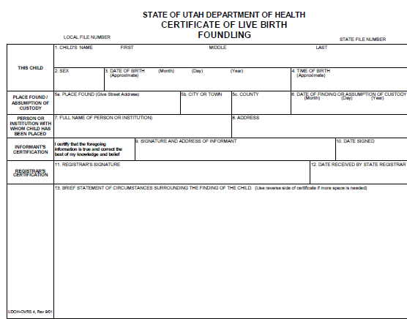

Slide 14
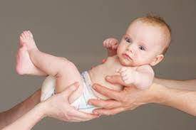
DCFS will find a foster family to take care of the newborn
A search will then be done to find an adoptive family

Slide 15
What communities are at risk?
ALL

Slide 16
Teens
Older mothers with other children
Women in abusive relationships
Religious beliefs and traditions

Slide 17
Who can drop-off a newborn?
Any designee of the birth parent

Slide 18
What Newborn Safe Haven Program Can Offer
Materials – Posters (English/Spanish)
Other support?
Questions?

Slide 19
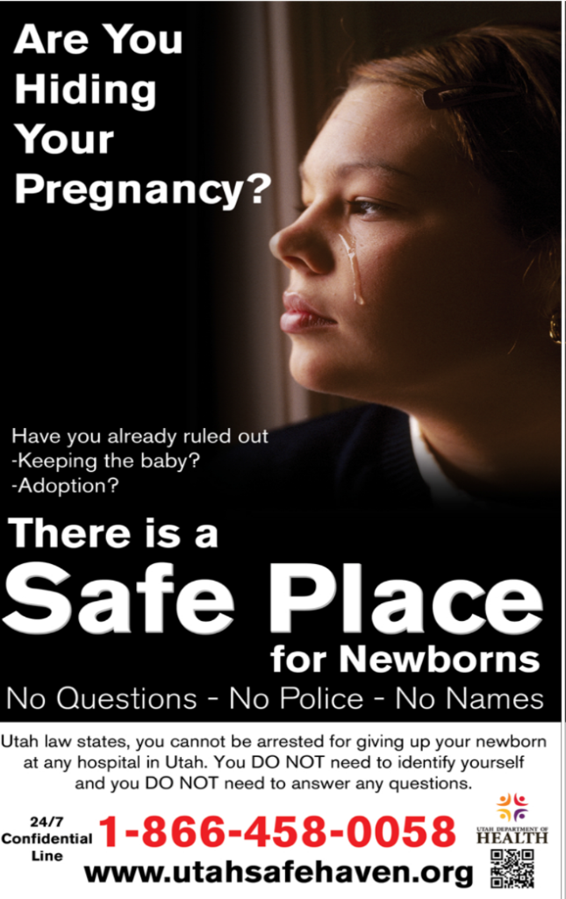
Old poster
New poster design coming up soon!

Slide 20
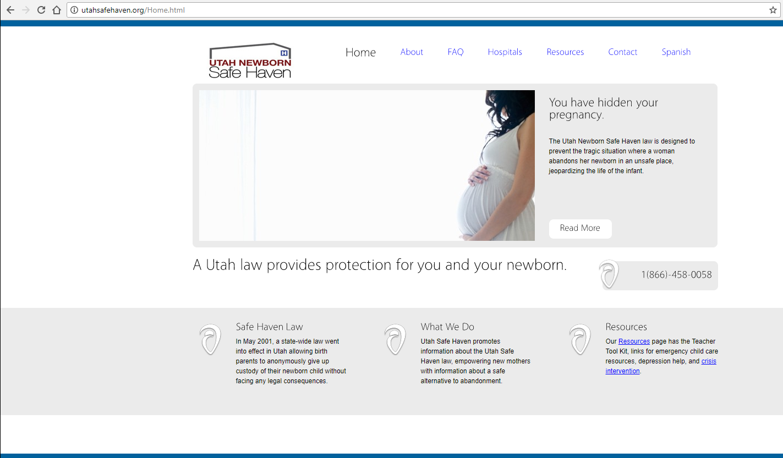
www.utahsafehaven.org

Slide 21
Questions
Utah Department of Health
Utah Newborn Safe Haven
Luisa Hansen
801-538-6924
lfhansen@utah.gov

